Slide 1
Stock Price Prediction (Apple, Microsoft) TEAM 6
Team Members:
Sofia Ataei
Bahareh Javadian
Shakiba Mashini
April 17th, 2024
Notes:
Thao

Slide 2






Agenda:
Problem Statement and Objective
Data Pre-processing & Exploratory analysis
Algorithms, Analysis, and Implementations
Results and Evaluation
Conclusions
Group Member Contributions
Notes:
Charanya

Slide 3
Problem Statement & Objective

Slide 4


The primary problem we aim to solve is predicting future stock prices for technology companies such as Apple and Microsoft.
Problem Statement | Project Objective
Challenges in Stock Market Prediction: Multitude of unpredictable factors influencing prices. Complexity in Predicting Tech Stocks: Tech giants' innovation and market dynamics complicate predictions. Limitations of Traditional Analysis in Tech Stock Prediction: Traditional analysis struggles with decoding tech stock prices variables. | Tech Stock Prediction Models: Leveraging historical data and market trends Advanced Machine Learning for Markets: Apply advanced machine learning techniques to interpret financial indicators. Enhancing Investment Strategies: Improve returns, and manage risk effectively with predictive modeling

Slide 5
Data Pre-processing & Exploratory Analysis

Slide 6

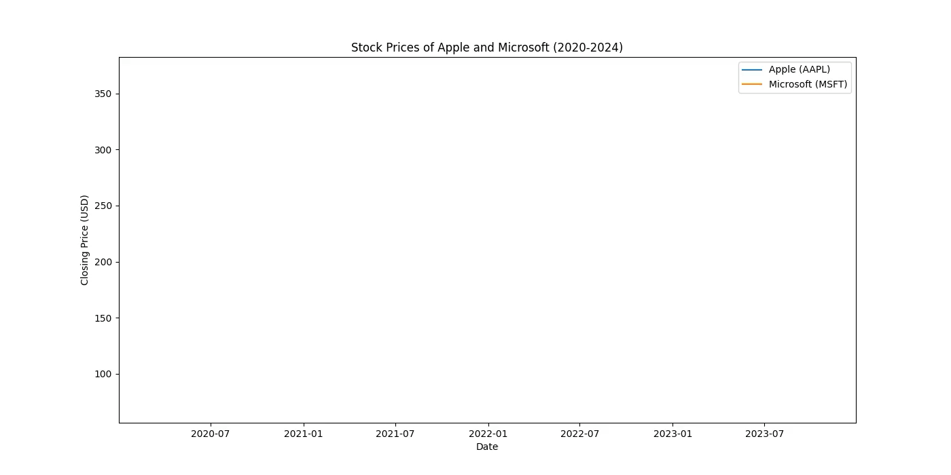
Overview of the Yfinance Dataset
Collection of daily trading data: Apple (AAPL) & Microsoft (MSFT) stocks.
The Date Range: January 1st, 2020, to January 1st, 2024
(capturing pre, during, and post-pandemic market behaviors).
Includes open, high, low, Closed prices and adjusted Closed prices alongside trading volume.
Aimed at capturing market trends, seasonality, and the impact of global events on stock prices.
This Photo by Unknown Author is licensed under CC BY-SA
Notes:
Thao

Slide 7
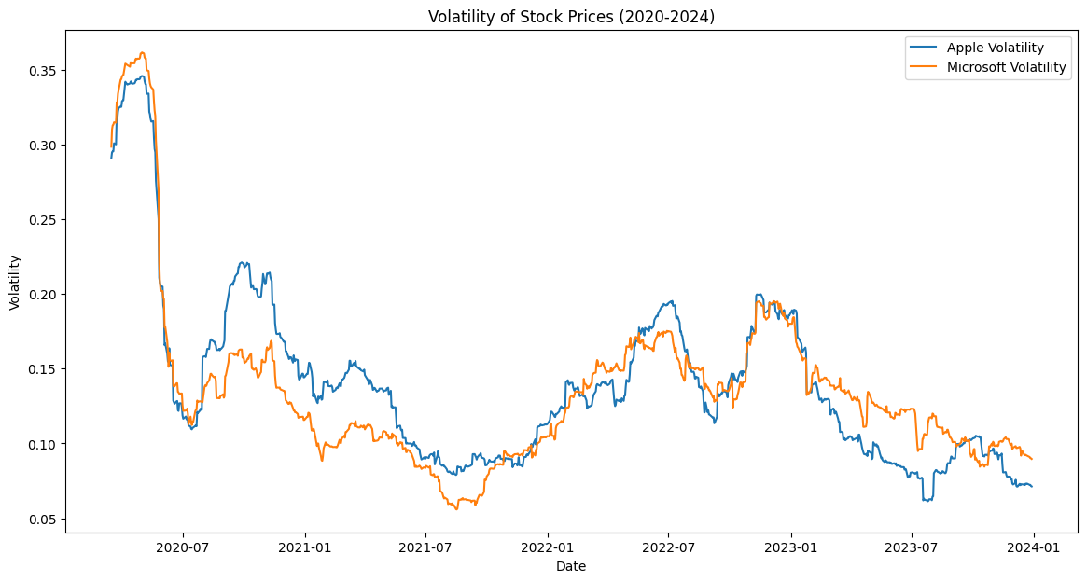
Evident Market Fluctuations: Demonstrates significant volatility, especially in early 2020, likely due to global events. Apple vs. Microsoft Volatility: Apple's stock is more volatile than Microsoft's, with greater price fluctuations. Volatility Trends: Both companies experienced a period of volatility early in 2021, followed by a gradual decline through mid-2022. Stabilization Phase: Post-mid-2022, both stocks exhibit a period of relative stabilization with lower volatility levels. Comparative Analysis: The volatility of Apple's stock price has remained consistent over time." Strategic Insight: Understanding volatility patterns is critical for timing market entry and exit for risk-conscious investors.
Volatility of Stock Prices

Slide 8
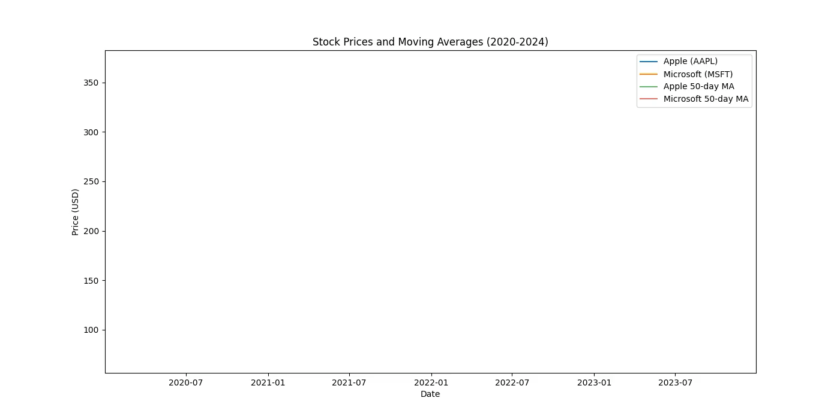
Stock Prices and Moving Averages
Upward Growth Trajectory: Apple and Microsoft exhibit "increasing trend" from 2020 to 2024.
Higher Volatility in AAPL: Apple shows greater price fluctuations.
AAPL vs. MSFT Valuation: Apple’s stock consistently trades at higher prices.
50-day MA as Trend Lens: The moving averages smooth out short-term noise, revealing the underlying trends.
Technical Indicators: Price crossovers with the moving averages may signal momentum changes.
Market Resilience: Both stocks display recovery from downturns.
Investor Sentiment: Moving averages tracking close to stock prices indicate stable investor valuation.

Slide 9
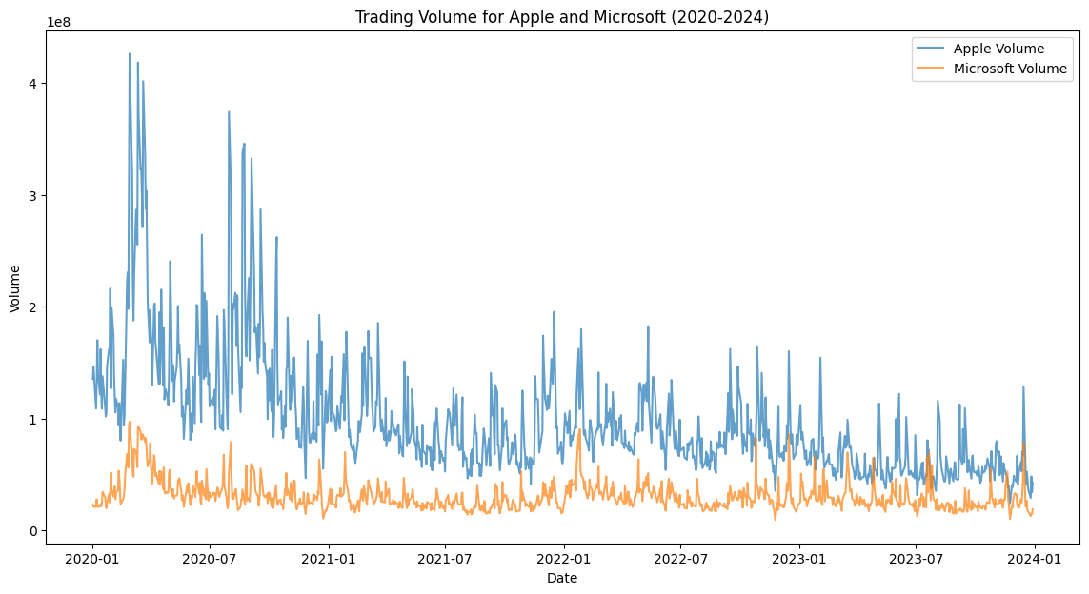
Initial Surge in Trading: High volume for both stocks at the onset of 2020. AAPL Trading Dominance: Apple generally sees higher trading volumes than Microsoft. Volume Decrease Over Time: A gradual decline in volume suggests market settling. Consistent Trading Activity: Both stocks maintain consistent interest throughout the period.
Trading Volume

Slide 10
Algorithms Analysis & Implementations

Slide 11



Prediction Models
Choosing the best ARIMA model
For each company:
Stationary or not?
Dickey fuller test
ACF & PACF
Three different ARIMA models
Differencing for making it stationary
LSTM(Long Short Term Memory)
Linear Regression

Slide 12
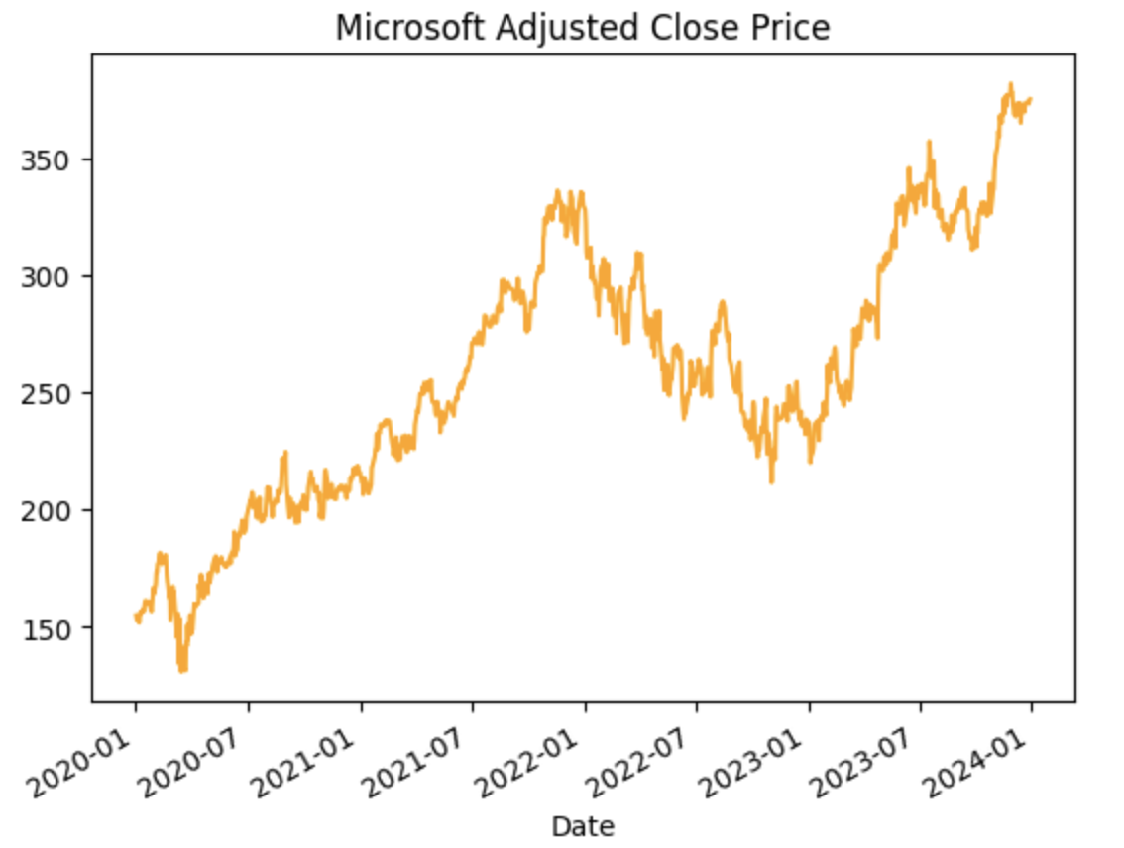
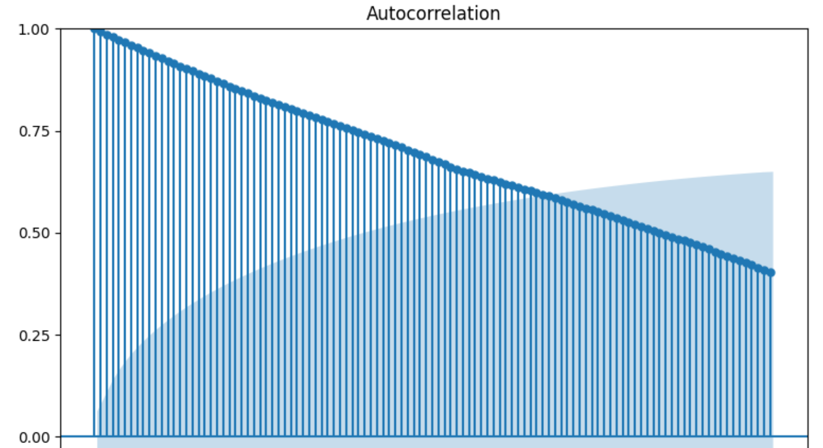
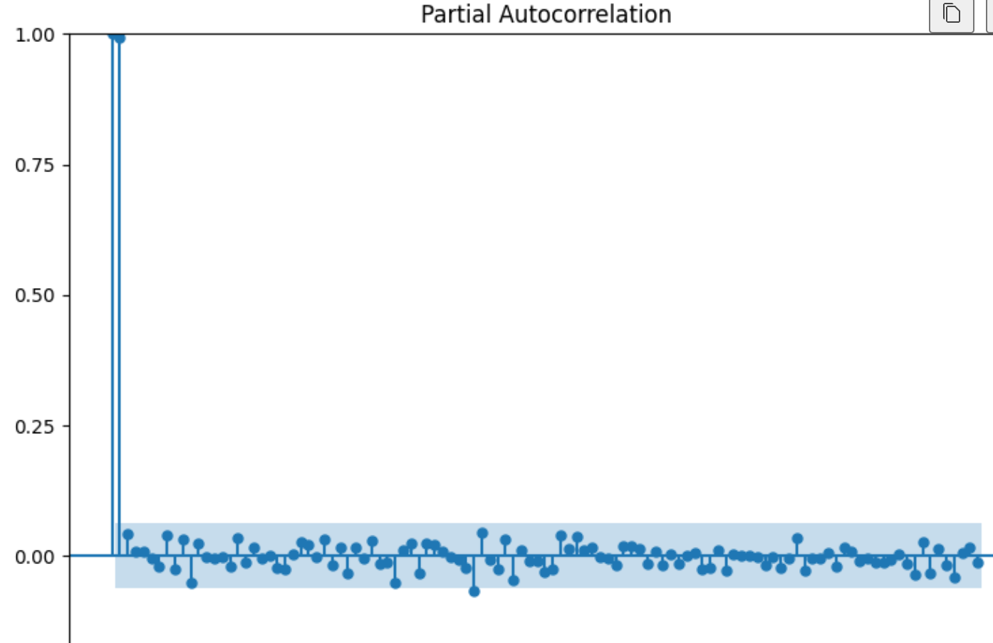
Microsoft
❌Seasonality
✅Positive Trend
ACF plot tails off
PACF plot cuts off after the lag 2
P-value of Dickey Fuller test = 0.753
After doing 1 differencing, the data becomes stationary.
ARIMA(2,1,0)
Two other ARIMA models:
ARIMA(1,1,1)
ARIMA(1,1,0)
LSTM
Linear Regression

Slide 13
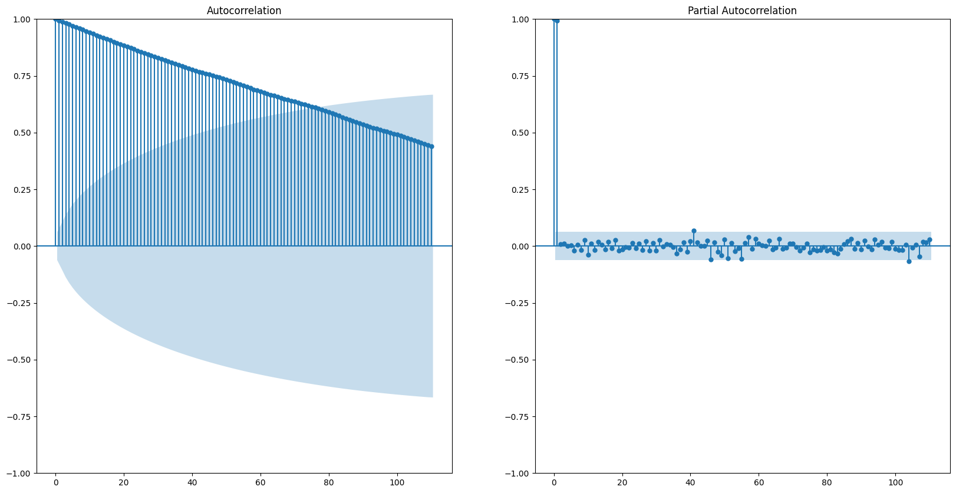
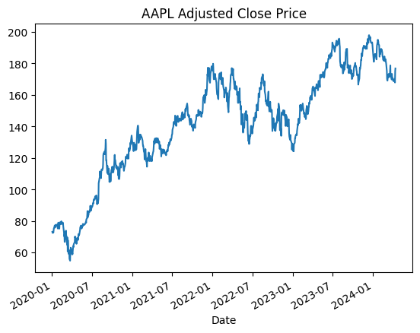
APPLE
❌Seasonality
✅Positive Trend
Non-Stationary
ACF plot tails off
PAC plot cuts off after the lag 2
After doing 1 differencing, the data becomes stationary
ARIMA(2,1,0)
Two other ARIMA models:
ARIMA(2,1,2)
ARIMA(2,1,1)
LSTM
Linear Regression

Slide 14
Results and Evaluation

Slide 15
Model's Performance Evaluation
Microsoft
Apple
Model | RMSE | AIC
ARIMA(2,1,1) | 4.743 | 4797.723
ARIMA(1,1,1) | 4.743 | 4795.767
ARIMA(1,1,0) | 4.949 | 5146.310
LSTM | 8.566 | -
Linear Regression | 7.284 | 7448.974
Model | RMSE | AIC
ARIMA(2,1,0) | 2.095 | 4163.609
ARIMA(2,1,2) | 2.10 | 4804.479
ARIMA(2,1,1) | 2.11 | 4806.112
LSTM | 2.13 | -
Linear Regression | 5.264 | 7300.950
Calculating (AIC) for LSTM is challenging due to the absence of a clearly defined likelihood function in neural network training

Slide 16
Conclusions

Slide 17


Conclusion & Suggestion
The results of our analysis suggest that ARIMA models outperform among other models in predicting stock prices.
While our analysis focused solely on utilizing past stock prices to forecast future prices, it's essential to acknowledge the potential impact of other factors such as trade volume, dividends, and company policies on share splits. Incorporating these additional variables into our predictive models could enhance their accuracy and robustness, providing a more comprehensive understanding of stock price dynamics.

Slide 18
Group Member Contributions

Slide 19
Distribution of workload:
The workload of our project were distributed evenly among all of us:
Data Preprocessing
Training 5 models for 2 companies
Comparison of Models

Slide 20
Thank you!

